Slide 1

Maltreatment and chronic widespread pain in the UK Biobank
A preliminary descriptive analysis
Timmins KA, Hales TG, Macfarlane GJ and the CAPE Consortium Investigators and Patient Partners

Slide 2
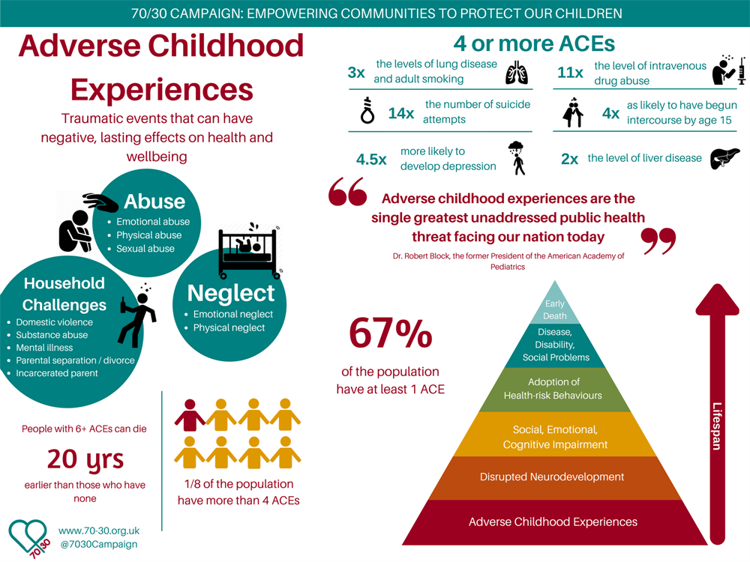
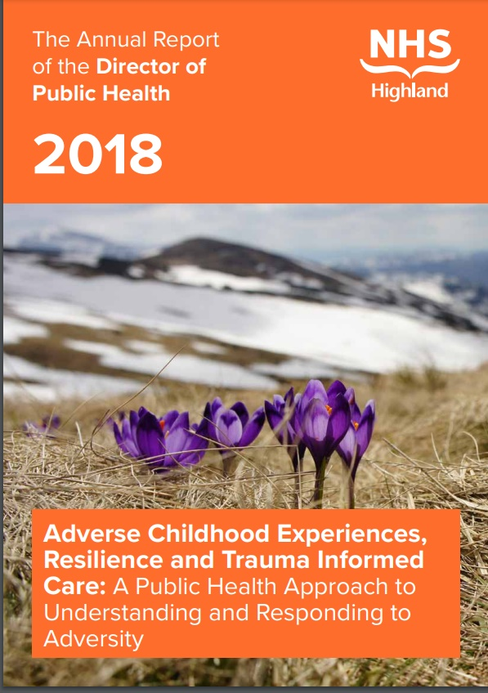

Slide 3
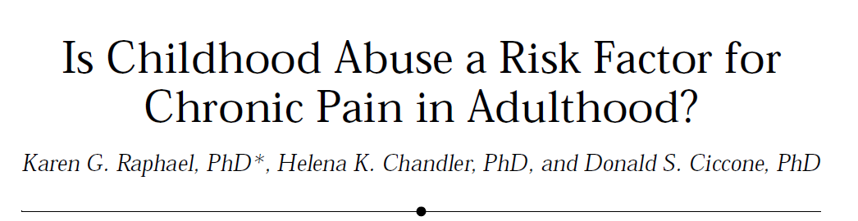
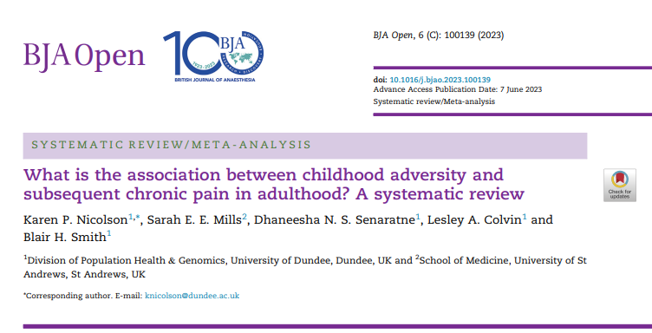
Adverse childhood experiences (ACEs) & chronic pain
2004 review (Raphael et al):
  12 cross-sectional, 13 case-control,
  2 prospective
  Consistent significant association in large cross-sectional studies not supported by prospective evidence
2023 systematic review
(Nicolson et al):
  50 cross-sectional, 14 case-control,
  4 prospective studies
  Consistent, ‘dose’-dependent associations

Slide 4









Chronic Pain
Advisory Group

Slide 5
CAPE WP2 objectives
Identify and enhance existing data from population-based prospective cohorts
Analyse the relationship between exposure to ACEs, chronic pain and treatment outcomes

Slide 6
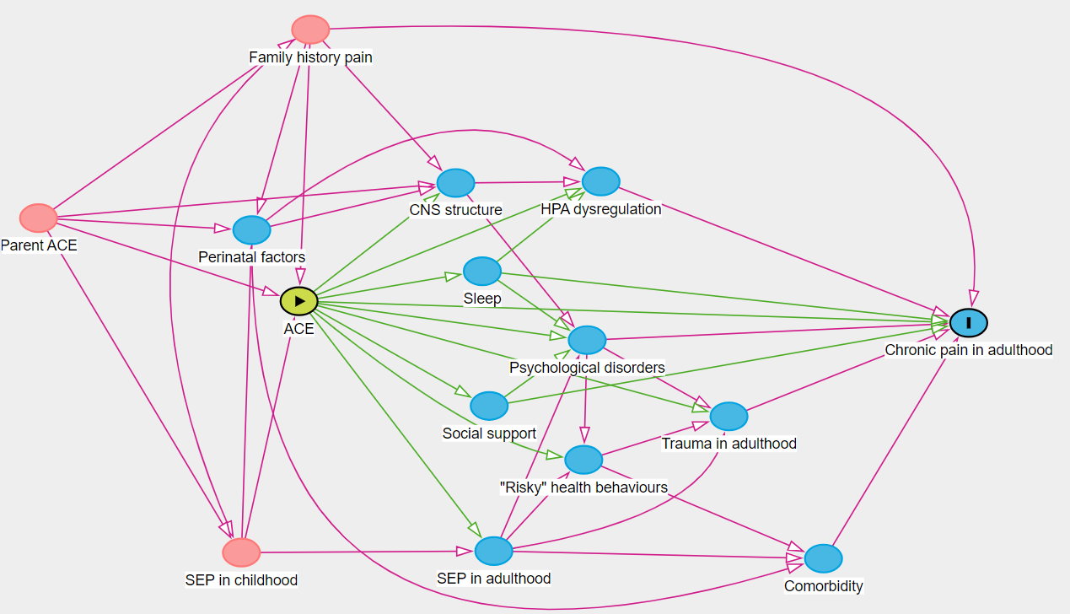
Pathways to pain
Moderators:
Sex, ethnicity
Mediators
Created using daggity.net
ACE = adverse childhood experience
CNS = central nervous system
SEP = socioeconomic position

Slide 7
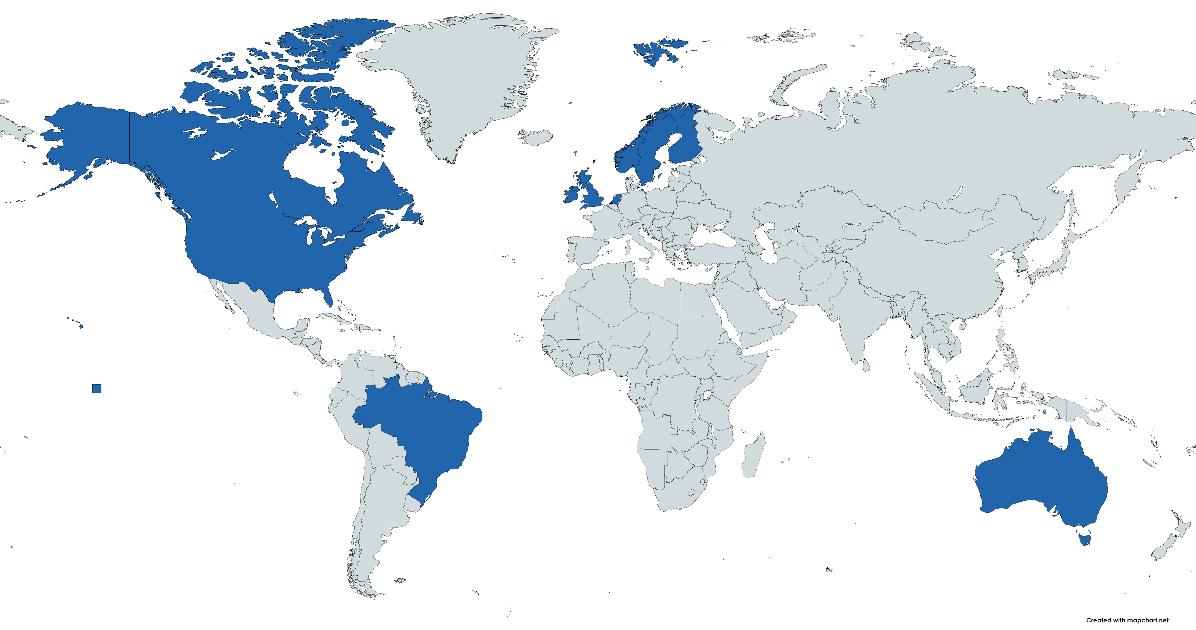
Identifying existing population-based prospective cohort data
We searched for:
We found: 29 cohorts
Population-based longitudinal cohorts of adults
n>2000
Sharable data in English
Data on adverse experiences during childhood (<18yrs)
Measures of chronic (>3mo) pain

Slide 8
Different adverse childhood experiences
Cohort studies
No details available

Slide 9

Today’s focus
Describe the prevalence in :
  childhood maltreatment
  chronic pain
  chronic pain all over (widespread)
  acute pain
This research has been conducted using the UK Biobank Resource under application number 1144.

Slide 10

Analysis sample
n=118,474
57% female
Mean 58 years @ recruitment
97% White
2006-2010
2016
2019
Recruitment
Online questionnaire
Online questionnaire
n=~500,00
40-69 years
“When I was growing up…
“I felt loved” (emotional neglect)
“There was someone to take me to the doctor if I needed it” (physical neglect)
“I felt that someone in my family hated me” (emotional abuse)
“People in my family hit me so hard that it left me with bruises or marks” (physical abuse)
“Someone molested me (sexually)” (sexual abuse)
“Are you troubled by pain or discomfort, either all the time or on and off, that has been present for more than 3 months?”
“In the last 3 months have you experienced pain or discomfort all over the body?”
“Have you been troubled by pain or tenderness during the past week?”

Slide 11
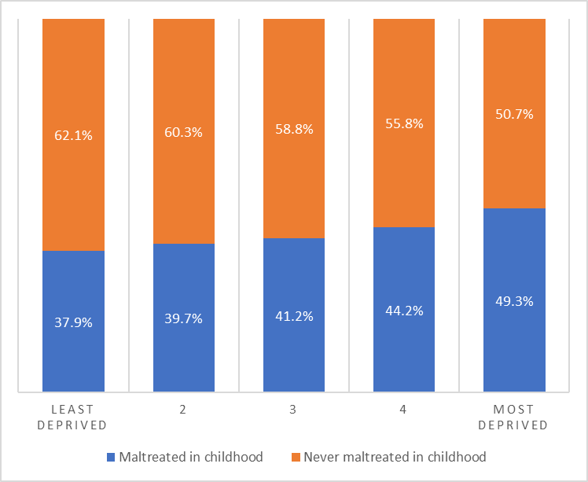
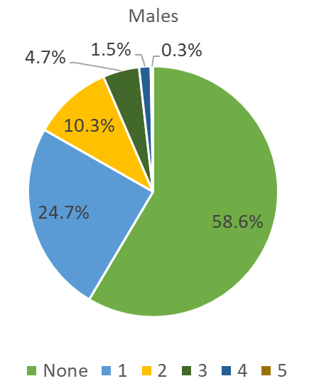
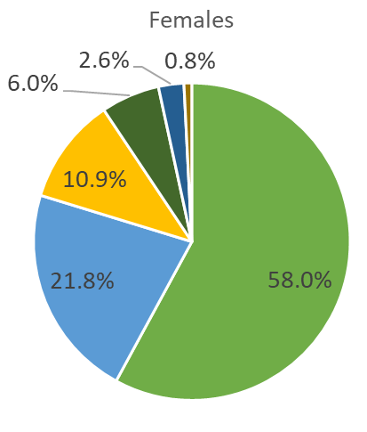
Childhood maltreatment
42% reported at least one of the maltreatment types

Slide 12
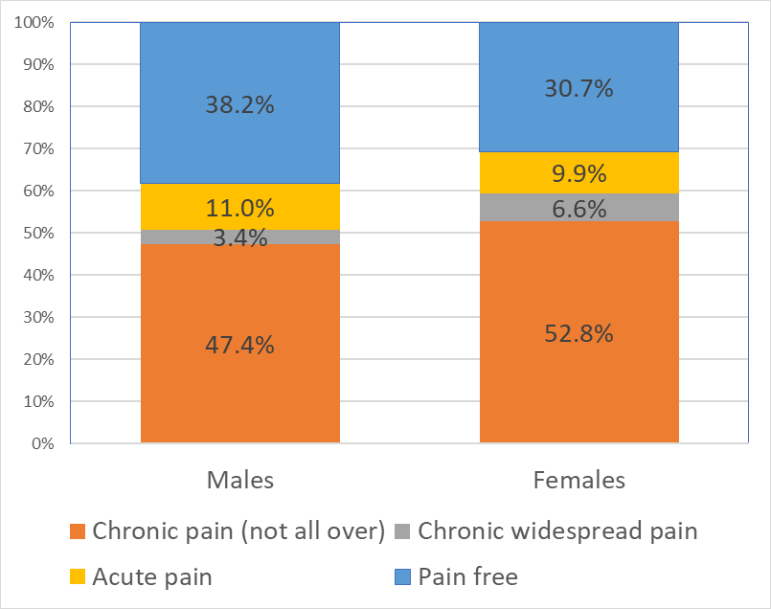
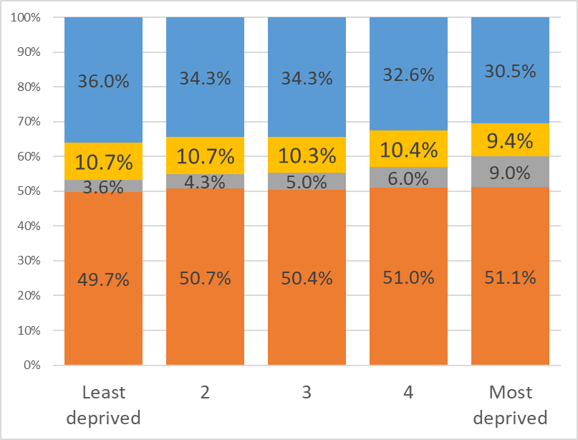
Pain

Slide 13
Childhood maltreatment & adult pain
Odds ratios (95% CI), adjusted for age, sex and deprivation quintile. Compared to never maltreated.

Slide 14
Sexual abuse & odds of pain

Slide 15
Physical abuse & odds of pain

Slide 16
Emotional abuse & odds of pain

Slide 17
Emotional neglect & odds of pain

Slide 18
Physical neglect & odds of pain

Slide 19

Ongoing work
More robust modelling
needed!
  Confounding
  Moderation
  Mediation
  Missing data
  Recall bias
Adopting a causal framework
Triangulation with other data sets to interrogate assumptions and bias

Slide 20

Take away messages
Preliminary observation:
  Important relationships between childhood maltreatment and chronic
  but not acute pain
More robust examination necessary
Understanding mechanisms could inform care for those at risk of poor outcomes.

Slide 21


